Slide 1
Redesigning Life After Retirement for Elderly People
CS6326 Human-Computer Interaction
Team Num: 1
Team Name: House of Designs
Team Members:
Vallabh Ashish Kedarisetti
Sheetal Nayak
Siddharth Sarangi
Tanmay Singhal

Slide 2
Three Tasks
Solution: An app that helps elderly people achieve a goal-oriented life after retirement, so they don't feel alone.
Simple
Connect retired elderly people with the world to achieve a sense of purpose and goal-oriented life
Moderate
Connect retired elderly people with people having similar interests rather than same age
Complex
Let them use their skills and experience to give back to the society and get acceptance

Slide 3
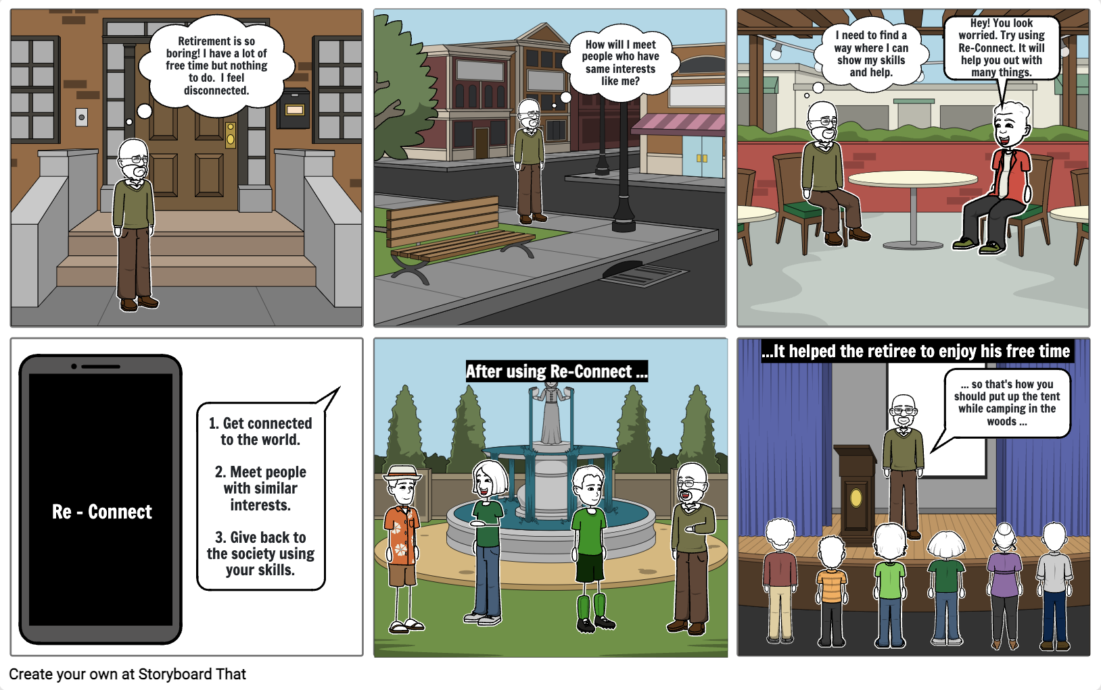
Video Planning Storyboard
Scene 1
Scene 2
Scene 3
Scene 4
Scene 5
Scene 6

Slide 4
Video Planning Storyboard
Key Characters
Our primary actor was David, whose old age suited our use case well. He played the target audience who would be using our application.
The second actor was Tanmay, who acted as a mediator between David and our application. He was instrumental in directing David to use our application.
We had 15 actors who played the role of the audience while David was giving his talk in scenes 5 and 6.
Dialogues
Scenes 1 and 2 do not require dialogues. David's expression and acting will suffice.
Scene 3 (at Starbucks)
Tanmay: Hey David! Good to see you after so long. How have you been?
David: I am doing good. I don't know what to do with my life now that I have so much time in my hands after retirement.
Tanmay: I have just the application for you. Try using Re-Connect. It will help connect with people around you with similar interests and much more. Just register here and select your favorite activities.
David: This seems interesting. I will surely give this a try.
Scene 4 explains the features of the application.
Scene 5 and 6 do not require dialogues. David and other actors' expression and body language will describe the scene.

Slide 5
Video Planning Storyboard
Scene 1 and 2
He comes out of his home and feels bored. He decides to go to Starbucks in hope that he would meet someone.
Scene 3 and 4
He sits alone at Starbucks and shares his problem with the person. That's when he comes to know about the Re-Connect application and how he can connect with people with similar interests and do many activities.
Using the application, he is able to perform task 1 and task 2. He is able to connect with the world by registering on the application and creating his own profile.
He is able to connect with people having similar interests by choosing his desired activities and hobbies.
Scene 5 and 6
He is talking to people with similar interest and hobbies like travelling and spirituality.
Guiding students abouts their resumes, soft skills, how to be more productive and how to manage in corporate life while coming from academic field.
He is able to complete task 3 by using his skills and experience for benefit of others.

Slide 6
Video Planning Storyboard
Camera Shots and Angles
Scenes 1 and 2 will shoot David from the front angle and show him opening the door of the house and walking towards Starbucks. We will show him entering Starbucks and sitting at a table with his drink.
Scene 3 will show Tanmay entering Starbucks and sitting next to David. We will zoom in on their conversation and then zoom in when David performs the tasks.
Scene 4 will pan the camera on the application and show David performing tasks 1 and 2 (i.e., simple and moderate tasks)
For scenes 5 and 6, the camera will zoom out on David and the people sitting around him. We will record David from the point of view of an audience who is listening to him speak.

Slide 7
Video
Link to out video
https://www.youtube.com/watch?v=aNiUN4OZ-yk

